Slide 1
Health Outcome Disparities Semi-Annual Report
Item # 22-3674
Presenters: Dr. Kiran Joshi, MPH - Senior Medical Officer & Co-Lead CCDPH
Dr. Rachel Rubin, MPH – Senior Medical Officer & Co-Lead CCDPH
June 2022

Slide 2
Cook County Board Resolution 22-1703 Analysis of Health Outcomes Disparities in Cook County and Recommended Solutions Approved March 2022
Assess Effectiveness of Existing County Policies & Recommended Changes
Identify Strategies to Coordinate Local, State and Federal Efforts
Recommend Action Plan & Implementation Plan Changes to Actively Engage Stakeholders
Align Existing Strategies & Plans to Reduce Disparities in Minority & Marginalized Populations
Recommend Legislative & Regulatory Changes to Improve Healthcare Outcomes
Recommend County Programs to Improve Access to Healthcare Services
Present Data/Performance Metrics to Improve Health Equity & Reduce Disparities

Slide 3
Initial Report
Terminology & Scope
Baseline Data & Analysis
Drivers of Health Disparities
Work in Progress
Next Steps
Notes:
-

Slide 4
Terminology & Scope

Slide 5
Definitions
Health Disparity | A disproportionate difference in health between groups.
Health Equity | The assurance of the conditions for optimal health for all people. Achieving health equity requires valuing all individuals and populations equally, recognizing and rectifying historical injustices, and providing resources according to need...” (Jones, 2014)
Health Inequities | Differences in population health status and mortality rates that are systemic, patterned, unfair, unjust, and actionable as opposed to random or caused by those who become ill. (Whitehead, 1992)
Social Determinants | The [population level] conditions in which people are born, grow, live, work and age,” which are “shaped by the distribution of money, power and resources.” (WHO, 2022)
Social Risk Factors | The [individual level] adverse social conditions associated with poor health, such as food insecurity and housing instability.” (Alderwick and Gottlieb, 2019)
Structural Racism | Macrolevel systems, social forces, institutions, ideologies, and processes that interact with one another to generate and reinforce inequities among racial and ethnic groups… [does] not require the actions or intent of individuals.” (Gee, 2011)

Slide 6
Health Equity Classical Public Health Model Modern Framework*
Social Determinants
Health Equity
Access to health care
Housing
Neighborhood
Work environment
Income
Structural Determinants
Race/class/gender (isms)
Economic policy
Social policy
Public policy
* Modified from Solar, O., & Irwin, A. (2007). A conceptual framework for action on the social determinants of health.

Slide 7
Baseline Data & Analysis

Slide 8
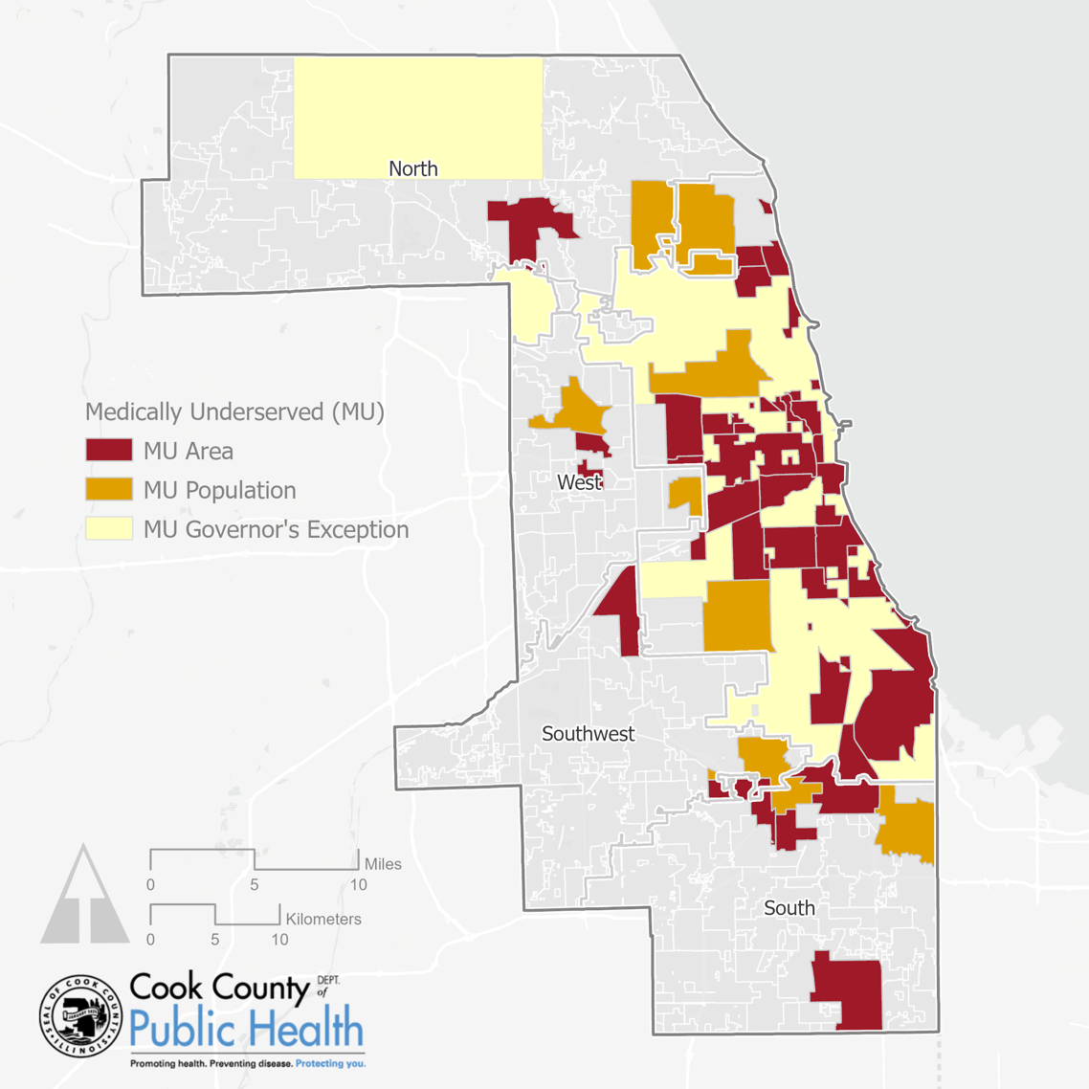
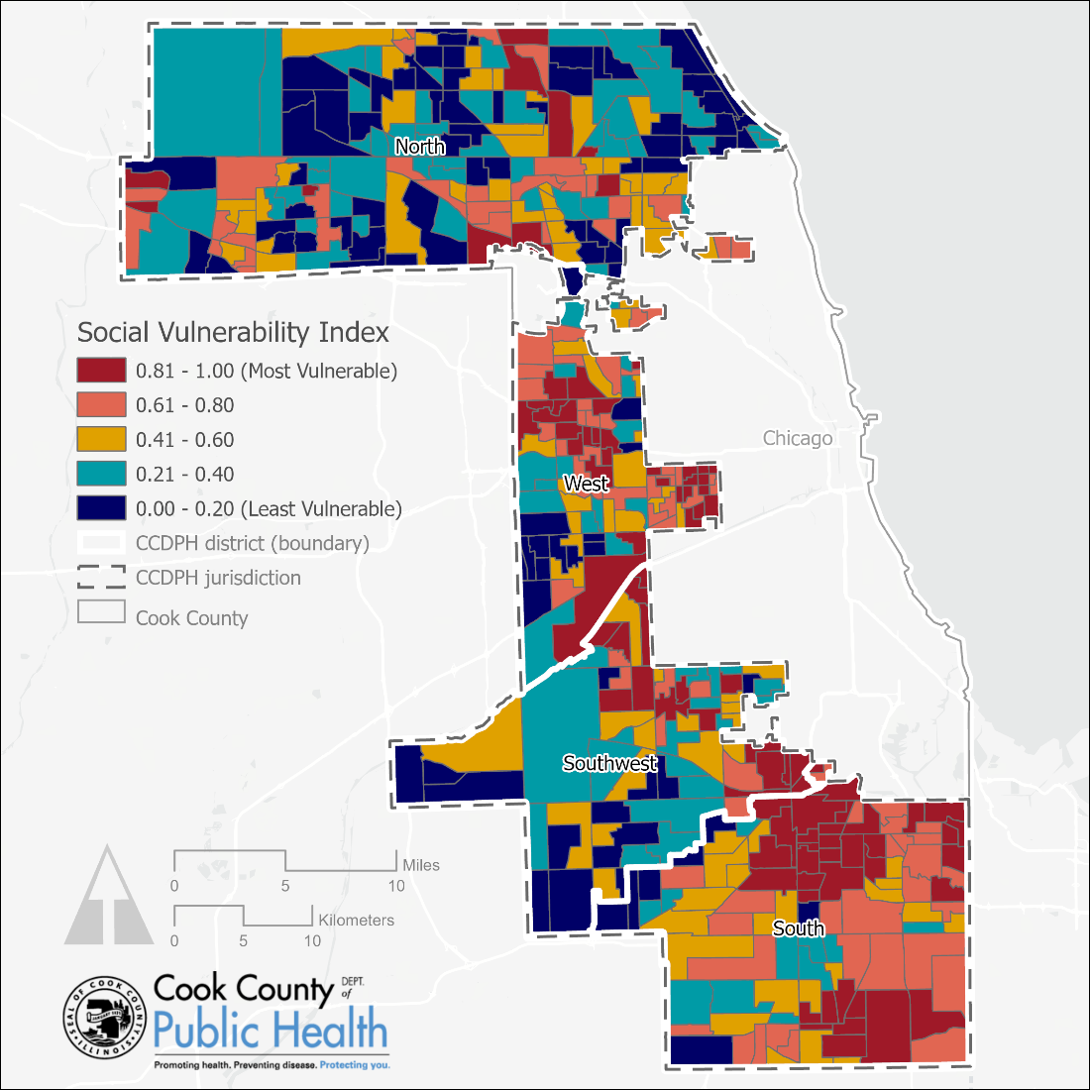
Similar Patterns Across Social Determinants
Medically Underserved Areas, 2020
Social Vulnerability Index, 2020
Notes:
Medically Underserved Areas, 2020 based on aggregations of census tracts
Data source: Health Resources and Services Administration, 2020 (https://data.hrsa.gov/data/download)
Social Vulnerability Index by Census Tract, 2020
Data source: CDC/ATSDR Social Vulnerability Index adapted by CCDPH’s Epidemiology Unit using American Community Survey 2016-2020 5-year estimates. (https://www.atsdr.cdc.gov/placeandhealth/svi/data_documentation_download.html)
Medically Underserved Areas (MUAs)
Designated places lacking adequate medical services according to federal guidelines. The data is useful for targeting areas for increased medical services.
Medically Underserved Populations (MUPs)
Some areas are underserving certain specific populations (such as those with low-income, or non-English speakers) and are designated as MUPs.
MU Population – Governor’s Exception
Additionally, the state’s governor (or other chief executive officer of the state) can designate areas that lack medical services in a particular area, these are labeled as “Governor’s Exception.”
Social Vulnerability Index by census tract- demographic and socioeconomic factors that affect the resilience of communities
Composed of indicators from the following domains:
1) Socioeconomic status
2) Household composition and disability
3) Minority status and language
4) Housing and transportation

Slide 9
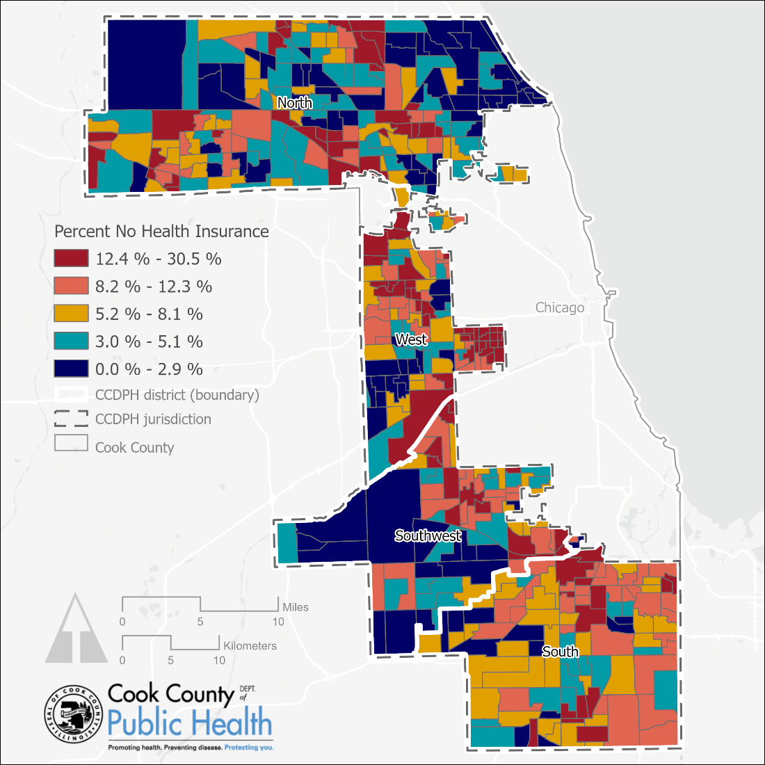
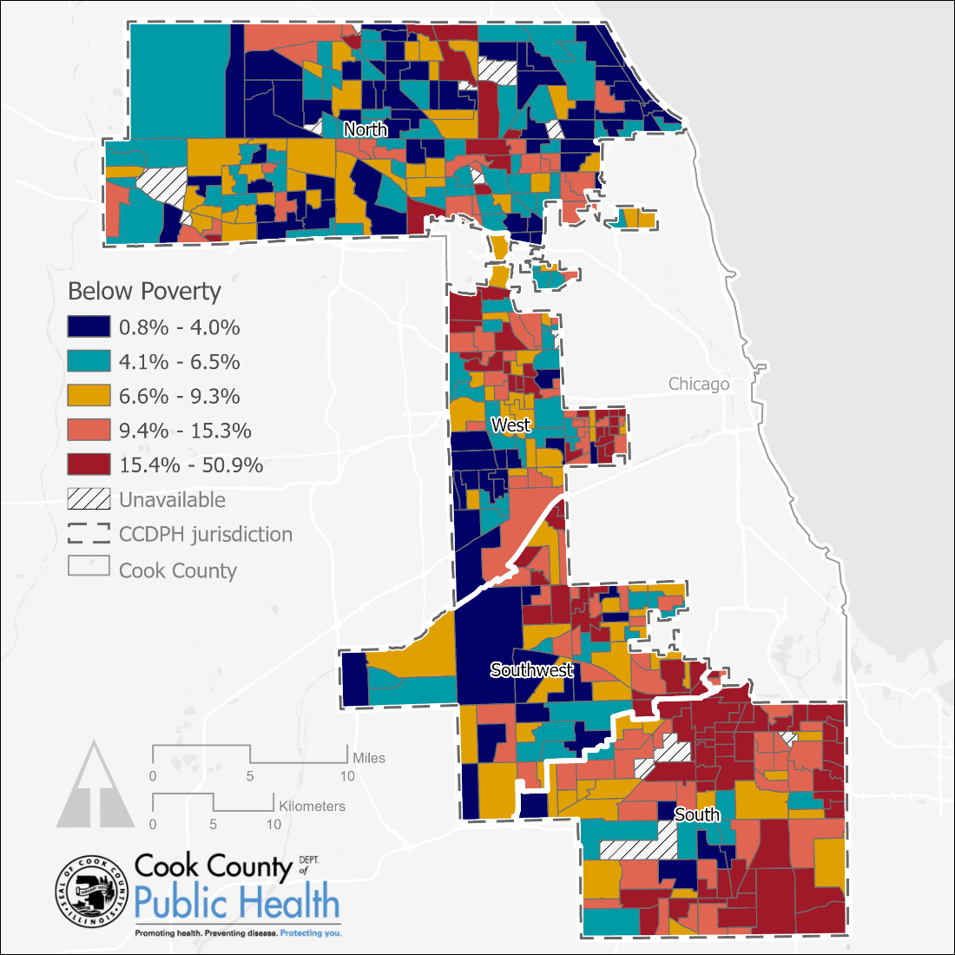
Similar Patterns Across Social Determinants
Percent No Health Insurance, 2019
Percent Earning Below Poverty Level, 2019
Notes:
Percent No Health Insurance by Census Tract, 2019
Data source: American Community Survey 2016-2020 5-year estimates
Percent of Population Residing in Households Earning Below Poverty Level Income by Census Tract, 2019
Data source: American Community Survey 2016-2020 5-year estimates

Slide 10
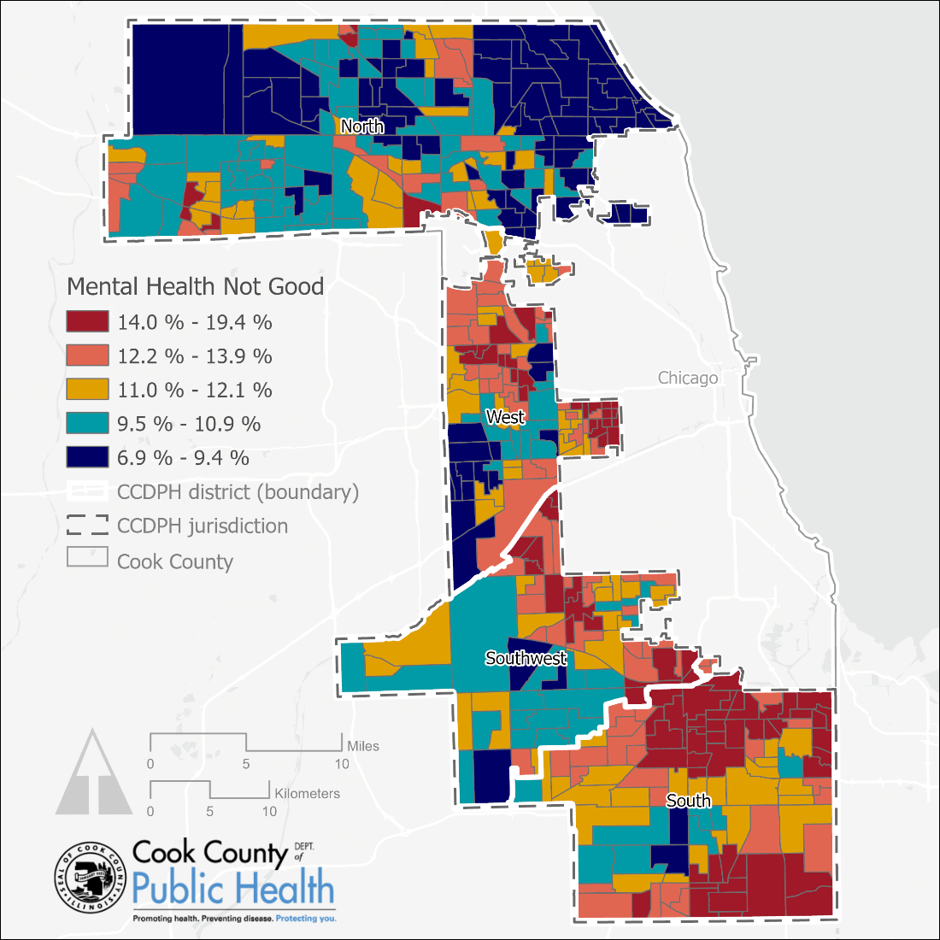
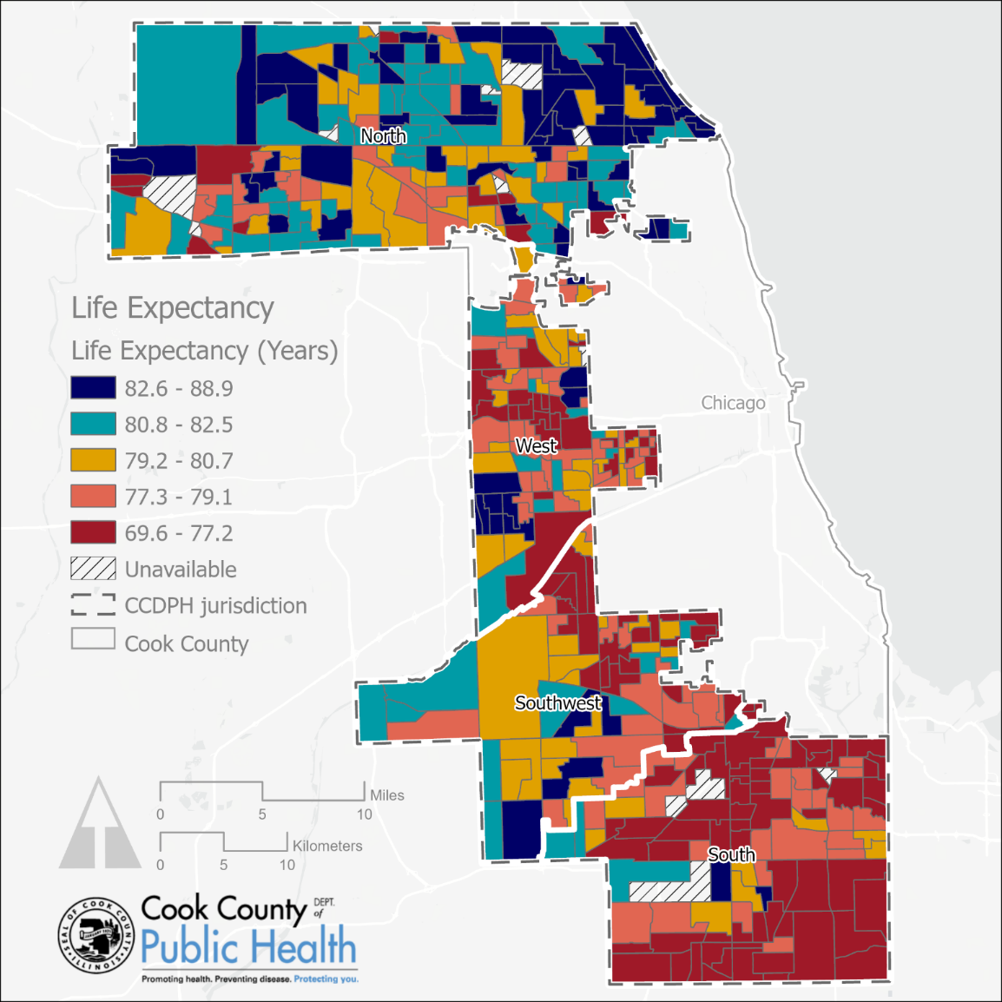
Similar Patterns Across Health Outcomes
Percent with Mental Health Not Good, 2019
Life Expectancy at Birth, 2019
Notes:
Percent with Mental Health Not Good for >= 14 Days Among Adults Aged >= 18 years by Census Tract, 2019
Data source: Center for Disease Control and Prevention, 2021 release based on Behavioral Risk Factor Surveillance System (BRFSS) 2018 and 2019 data (https://www.cdc.gov/places)
Life Expectancy at Birth by Census Tract, 2019
National Center for Health Statistics. U.S. Life Expectancy at Birth by State and Census Tract. Date accessed January 15, 2022. (https://data.cdc.gov/d/5h56-n989)

Slide 11
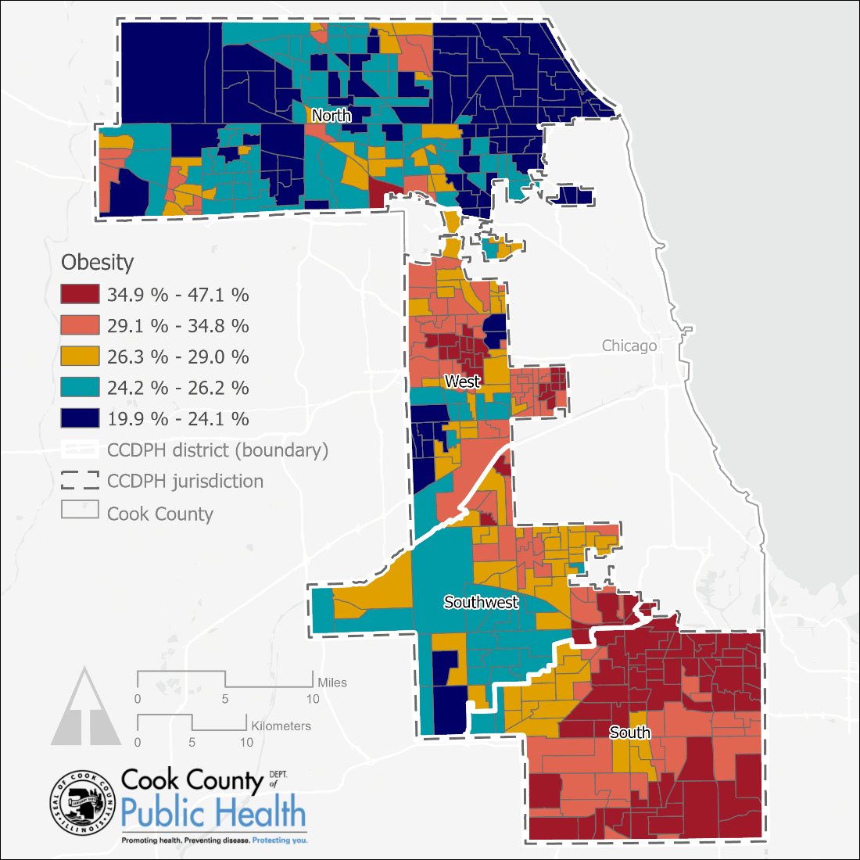
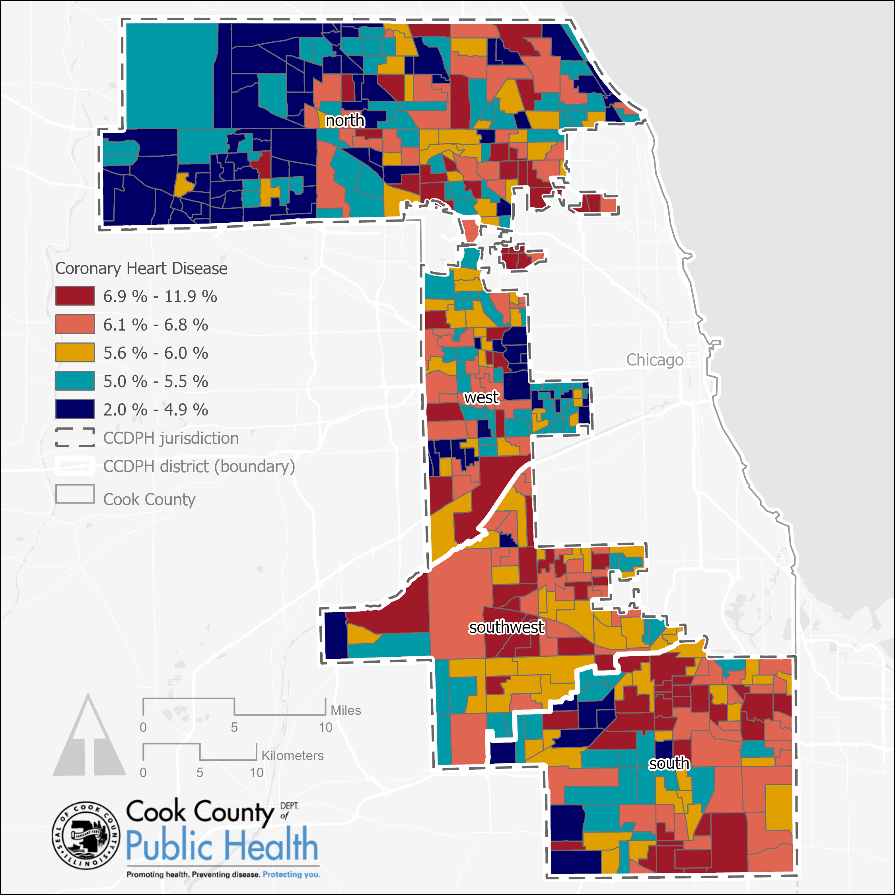
Similar Patterns Across Health Outcomes
Percent Obese, 2019
Heart Disease Prevalence, 2019
Notes:
Percent Obese Among Adults Aged >= 18 years by Census Tract, 2019
Data source: Center for Disease Control and Prevention, 2021 release based on Behavioral Risk Factor Surveillance System (BRFSS) 2018 and 2019 data (https://www.cdc.gov/places)
Coronary Heart Disease Among Adults Aged >= 18 years by Census Tract, 2019
Data source: Center for Disease Control and Prevention, 2021 release based on Behavioral Risk Factor Surveillance System (BRFSS) 2018 and 2019 data (https://www.cdc.gov/places)

Slide 12
Drivers of Health Disparities

Slide 13
Drivers of Health Disparities
Structural Racism
Redlining
Racial Gaps in Income
XX
XX

Slide 14
Structural Racism and Health
Economic injustice
Deprivation, less access to health promoting environments
Environmental and occupational health inequities
Targeted marketing of health harming substances
Lower access to quality healthcare
Political exclusion
Mass incarceration
Regressive education funding policy
Bailey, Z. D., Krieger, N., Agénor, M., Graves, J., Linos, N., & Bassett, M. T. (2017). America: Equity and Equality in Health 3 Structural racism and health inequities in the USA: evidence and interventions. In www.thelancet.com (Vol. 389). https://doi.org/10.1016/S0140-6736(17)30569-X

Slide 15
Analysis
Health Inequities are Societal Problems that Require Societal Solutions
History of Discrimination and Racist Policies Have Disproportionately Affected Near West & South Cook County Residents
Result – Areas of Concentrated Poverty & Low Opportunity
Racist Structures & their Impact Persist
Result – Area Populations Experience Worse Health Outcomes

Slide 16
Work in Progress

Slide 17
CCDPH Health Equity Initiatives
Suburban Cook County Worker Protection Program
Piloted in 2018 - Focused on Minimum Wage Increase and Earned Sick Time
Pivoted to COVID Protections During Pandemic to Prevent the Spread and Unnecessary Death
Next Steps will Identify and Address Violations, Improve Compliance
CCDPH COVID Contact Tracing Initiative Care Resource Coordination
Connect to Resources to Meet Immediate Needs & Provide Longer-Term Supports to Most Vulnerable
Lead Poisoning Prevention
Additional Funds to Expand Services to Lower to Middle Income Families
Local Transportation Funding
Integrate Health Considerations into the Evaluation of Surface Transportation Projects
75% of the 19 Transportation Projects Funded by XXX in 2020 are Located in Suburban Cook County Municipalities with High Social Vulnerability Index (SVI) Scores.
$12 million in Funding Awarded by XXX to XXX for XXX
Notes:
SCC WPP NOTES HERE
CTI CRC NOTES HERE
LEAD NOTES HERE
LOCAL TX NOTES HERE

Slide 18
Building Healthy Communities Initiative
$12M in grants available using a combination of funds from ARPA, the CDC and IDPH
Support local organizations in expanding programs promoting mental health, food security, and positive youth development across Cook County.
Support on-going COVID-19 response, resiliency, and recovery, and aim to
continue to prevent and control the spread of COVID-19,
lessen the health, social and economic impacts, and reduce COVID-19 health disparities, in communities and populations disproportionately burdened by the pandemic.
Currently in process of evaluating close to 70 proposals submitted for funding.

Slide 19
CCH Strategic Plan Initiatives 2023-2025
Impact Social Determinants and Advocate for Patients
Equity and Inclusion Office Established
Community Advisory Councils Established at all Cook County Health Centers
Implemented Value-added Benefits for CountyCare members
CountyCare invested $5M in the Flexible Housing Pool
to Provide Housing to CountyCare members
Established community COVID-19 vaccine program and information portal.
Administered 1 million COVID-19 vaccines
Conducted hyper-local campaign for COVID-19 vaccines led by CCDPH

Slide 20
Next Steps

Slide 21
Future Goals
Leverage Existing CCH Assets / Resources
The Change Institute
CountyCare
XXX – ie. County JAC, BED…
Transformation
ARPA
Integrate Existing Strategies & Initiatives
WePlan 2025
CCDPH Strategic Plan 20XX
CCH Strategic Plan 2023-2025
XXX

